Slide 1
Directions
Work with your group to sort the cards into categories that are based on similar body parts.
Explain your thinking as you sort the cards.
Notes:
Tell participants that they will now engage in an investigation to learn more about plants and animals that live in a pond environment. Introduce the animal and plant body part cards. Invite participants to work with a group to sort the cards into categories based on similar body parts. Encourage participants to explain their thinking as they sort the cards.
Afterward, invite groups to share how they sorted the cards into categories. Highlight similarities and differences among participant responses.
Facilitation Note: Use your discretion to decide how many minutes to give participants for this activity.

Slide 2
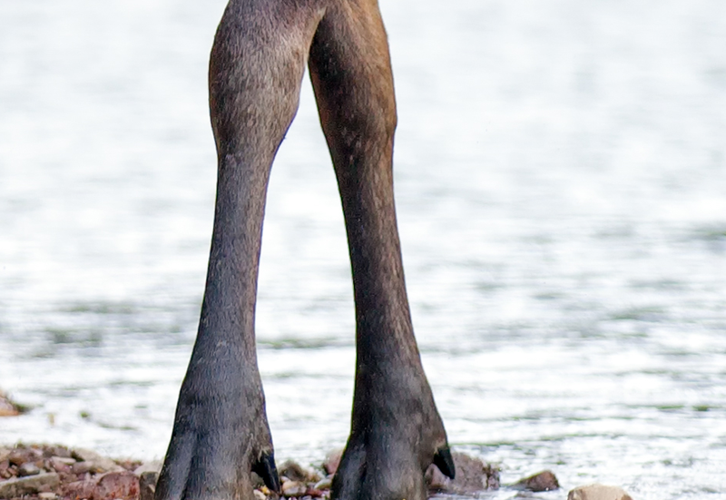
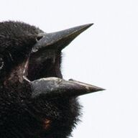
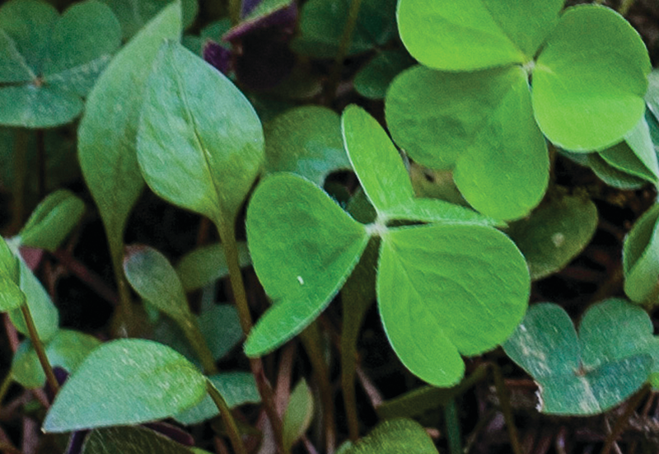
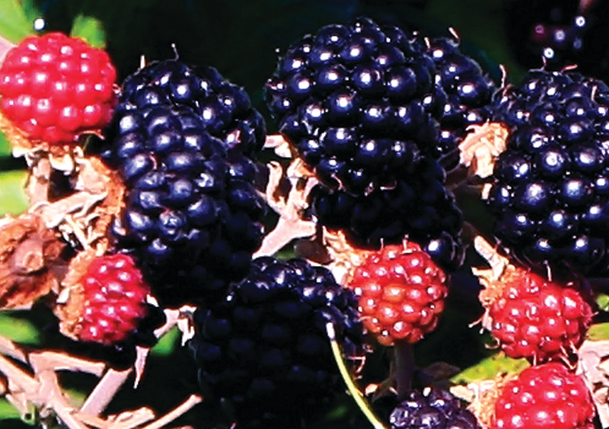
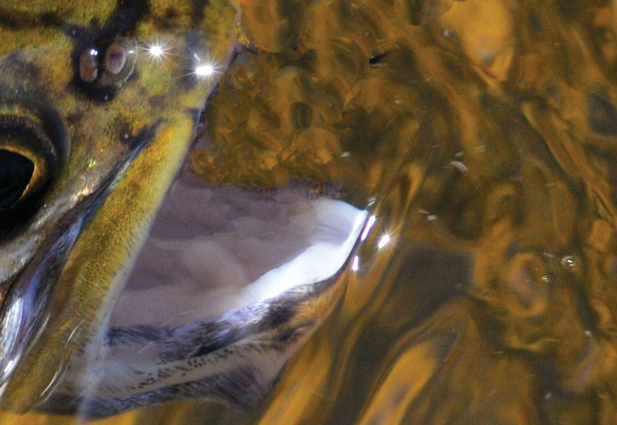
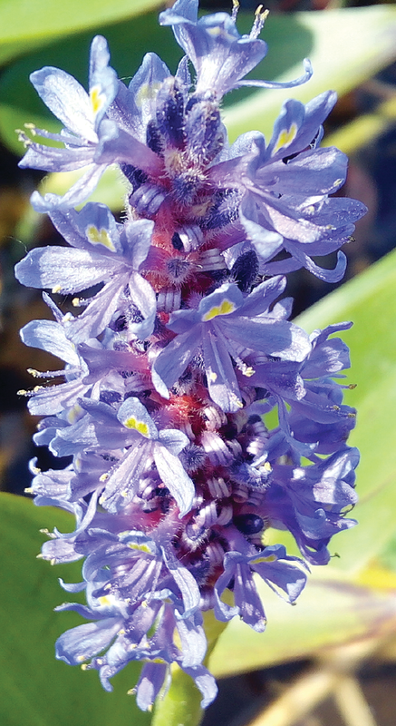
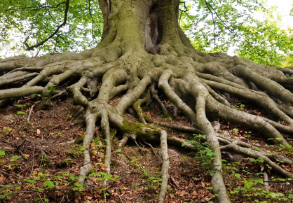
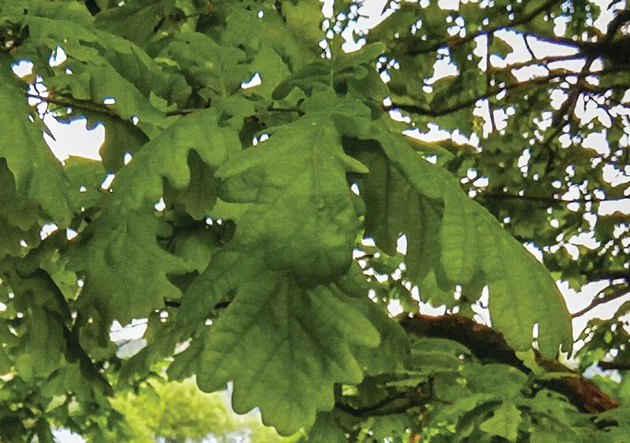
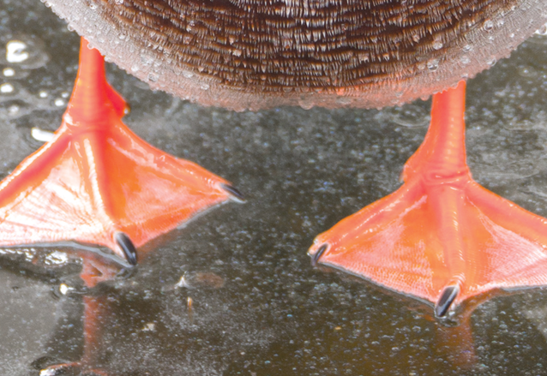
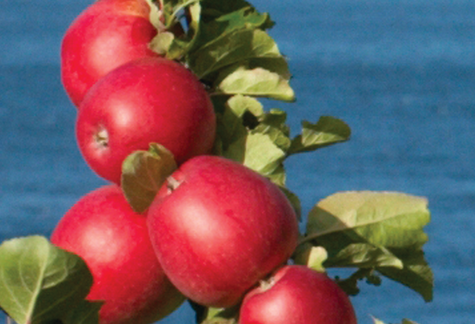
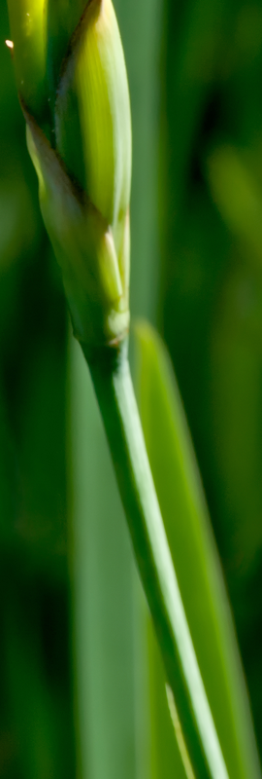
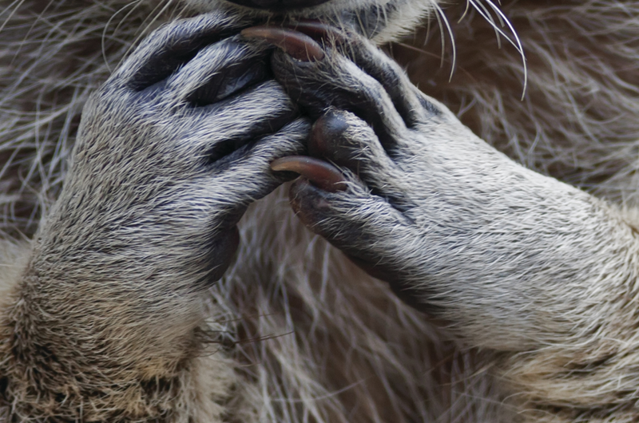
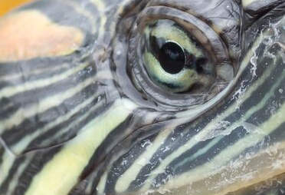
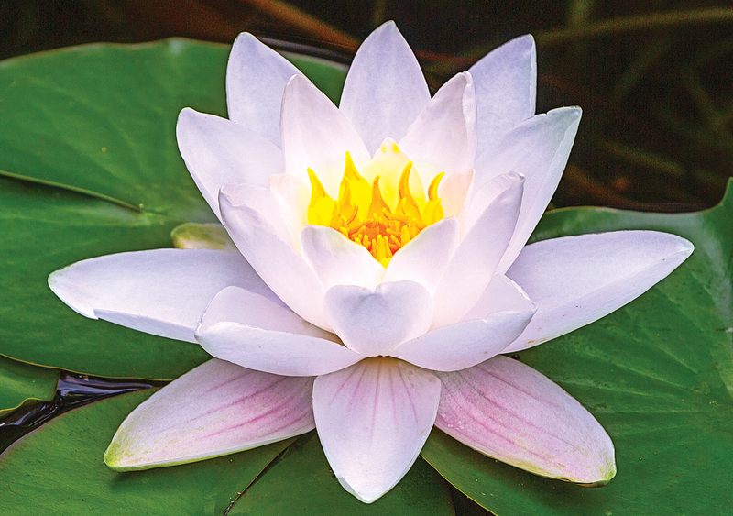
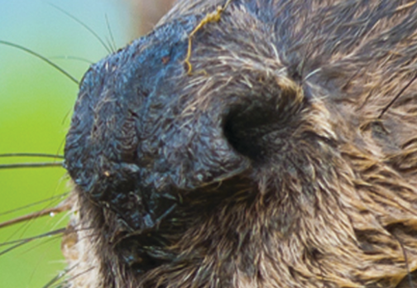
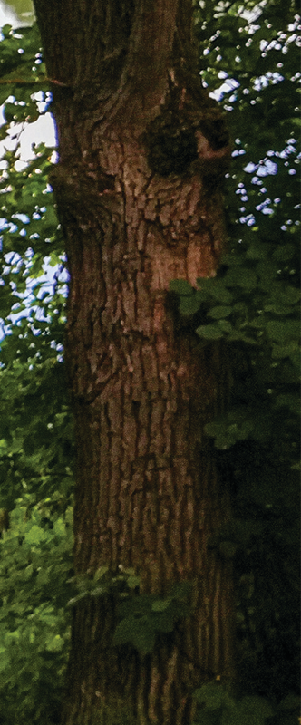
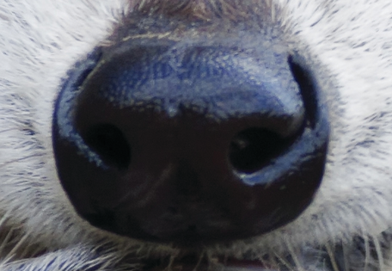
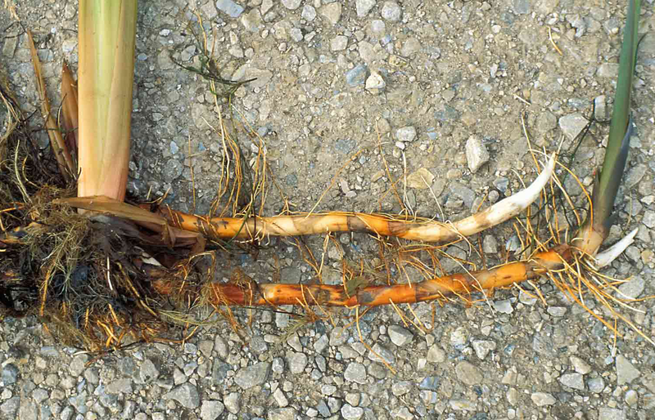
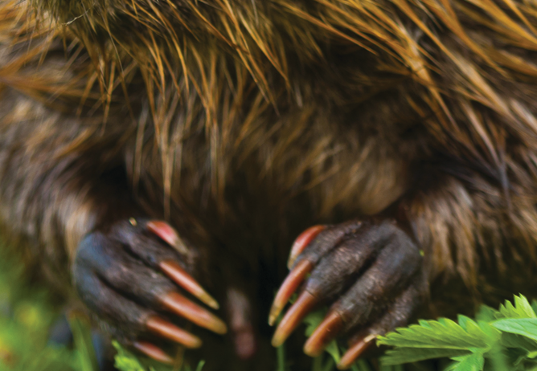
Card Sort
Notes:
Tell participants that they will now engage in an investigation to learn more about plants and animals that live in a pond environment. Introduce the animal and plant body part cards. Invite participants to work with a group to sort the cards into categories based on similar body parts. Encourage participants to explain their thinking as they sort the cards.
Afterward, invite groups to share how they sorted the cards into categories. Highlight similarities and differences among participant responses.
Facilitation Note: Use your discretion to decide how many minutes to give participants for this activity.

