Slide 1
Card Sort Directions
Work with your group to sort the cards into categories.
The cards in each category should be related.
Explain your thinking as you sort the cards.
Notes:
Tell students they will work with their group to observe photographs to learn more about where butterflies live.
(VIRTUAL DIRECTIONS ABOUT SMALL GROUPS AND BREAKOUT ROOMS)
Distribute a set of organism cards to each group. Ask students to sort the cards into categories of their choice. Tell students that the cards in each category should be related and that they must be able to justify why they grouped the cards the way they did. After providing students a few minutes to sort the cards, ask for volunteers from each group to share the categories they came up with.
Ask students in each group to put all their cards back into one pile. Challenge students to think of a single category that includes all the cards.
What would you title this category?
VIRTUAL SESSION:
Direct participants to the Level 3 Module 2 Lesson 1 Card Sort PowerPoint file on the landing page. Instruct participants to work in groups to sort the cards into categories of their choice. Inform groups that they should be able to explain and justify their choices.
Send the landing page link through the chat: https://science.greatminds.org/pd/virtual-k-5-launch
Send directions through the chat.
Create breakout rooms of 3–5 participants.
Send participants to breakout rooms for 4 minutes.
After participants return from their breakout rooms, have each group’s reporter share the categories their group created and how they grouped the cards. Ask participants the following question: If you had to group the cards into a single category, what would it be? Why?
Tell participants that this lesson introduces students to the term organism, which describes all living things, including all plants and animals, but that students have the opportunity to engage in an investigation before the term is introduced and defined.
Remind participants of the butterfly sketch they drew. Invite participants to update their sketch to show where a butterfly lives and what it needs to survive. Remind participants that the organisms they observed in the card sort activity can all be found where butterflies live. Give participants 2 minutes to complete their sketch.

Slide 2
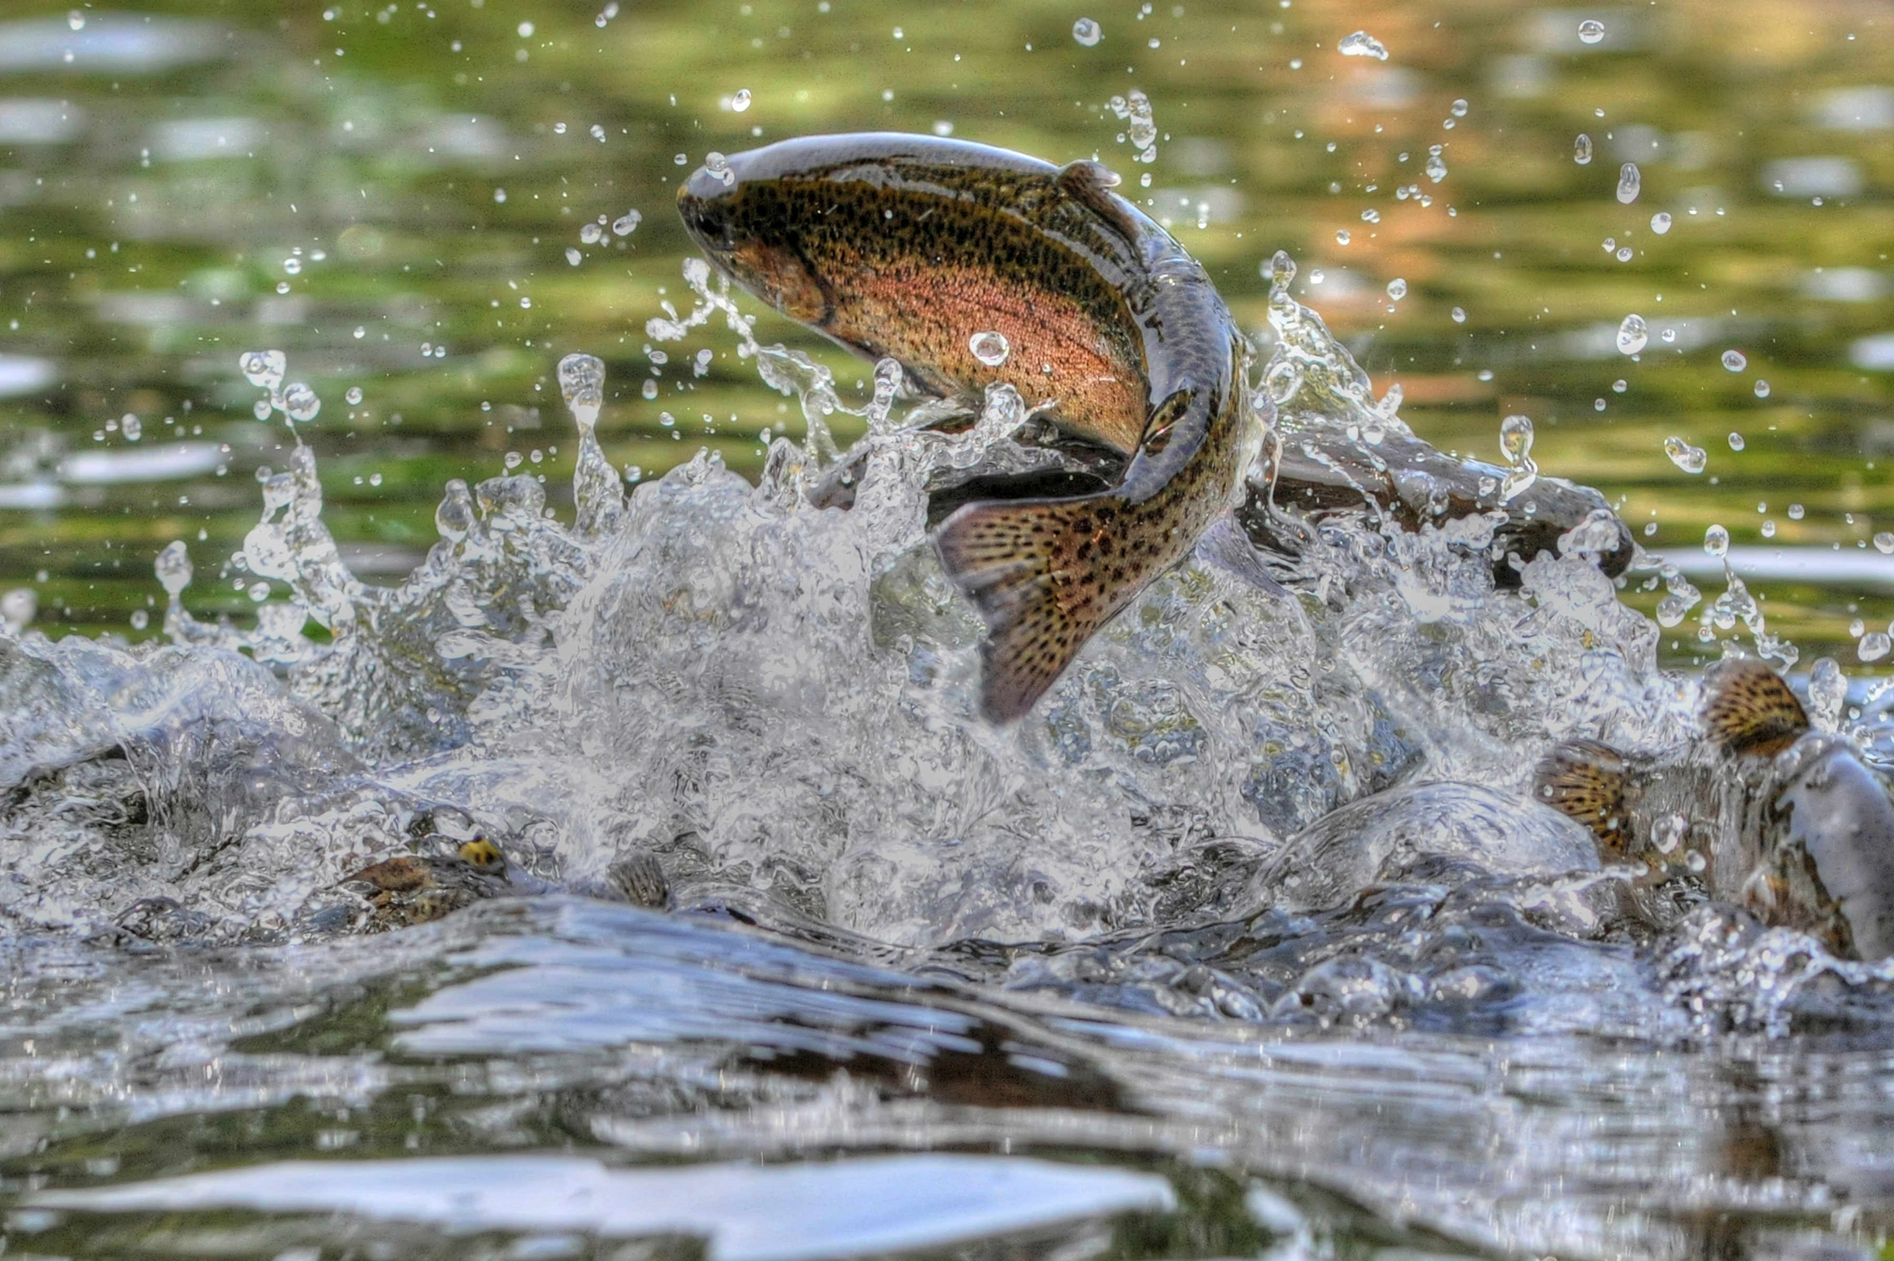
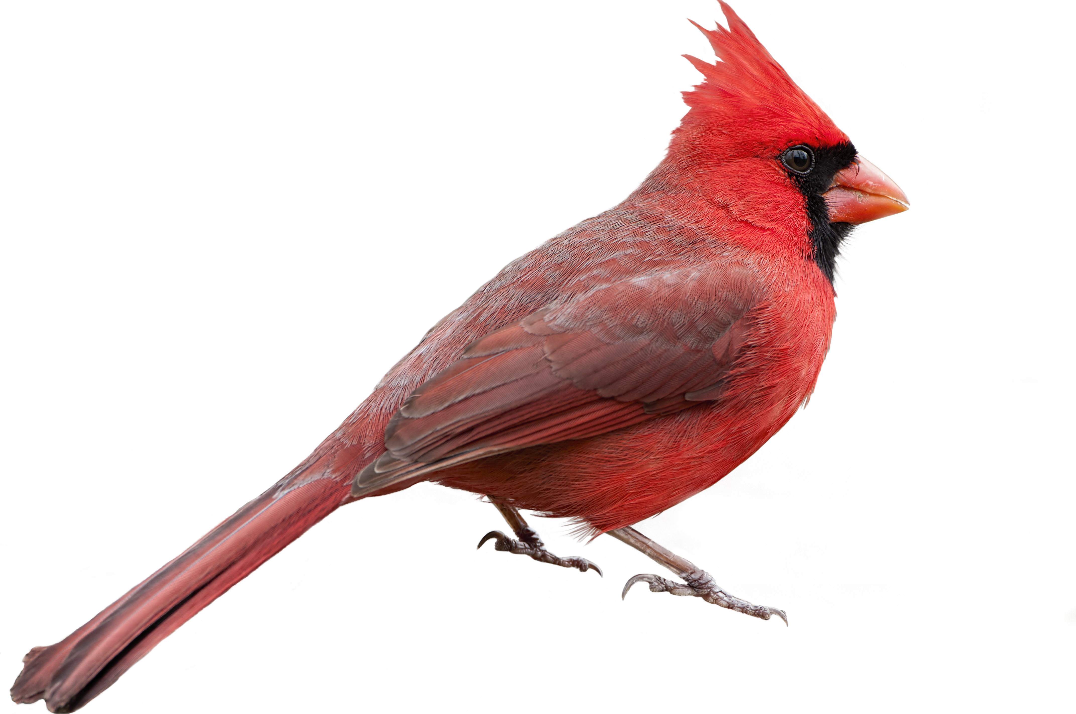
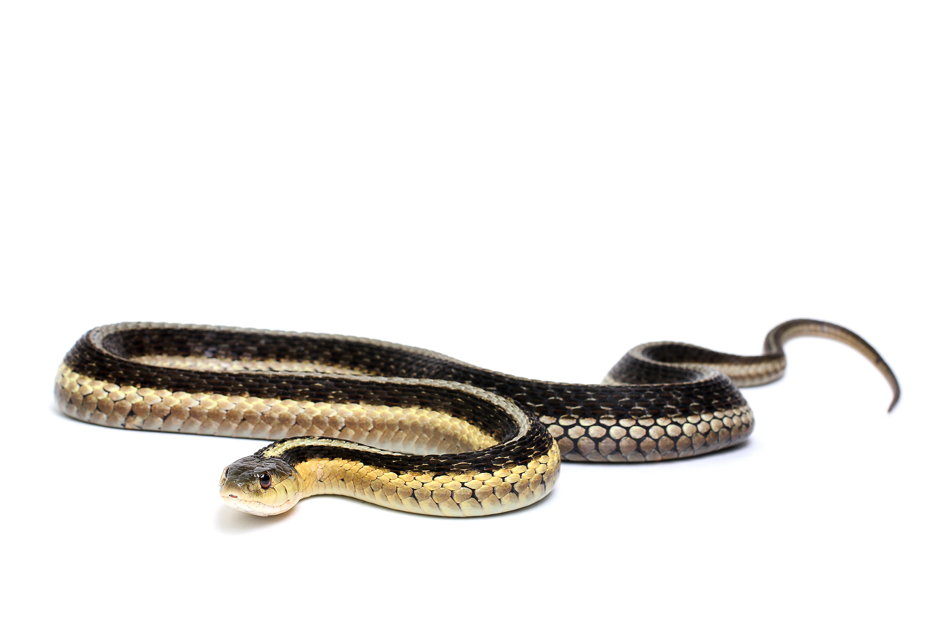
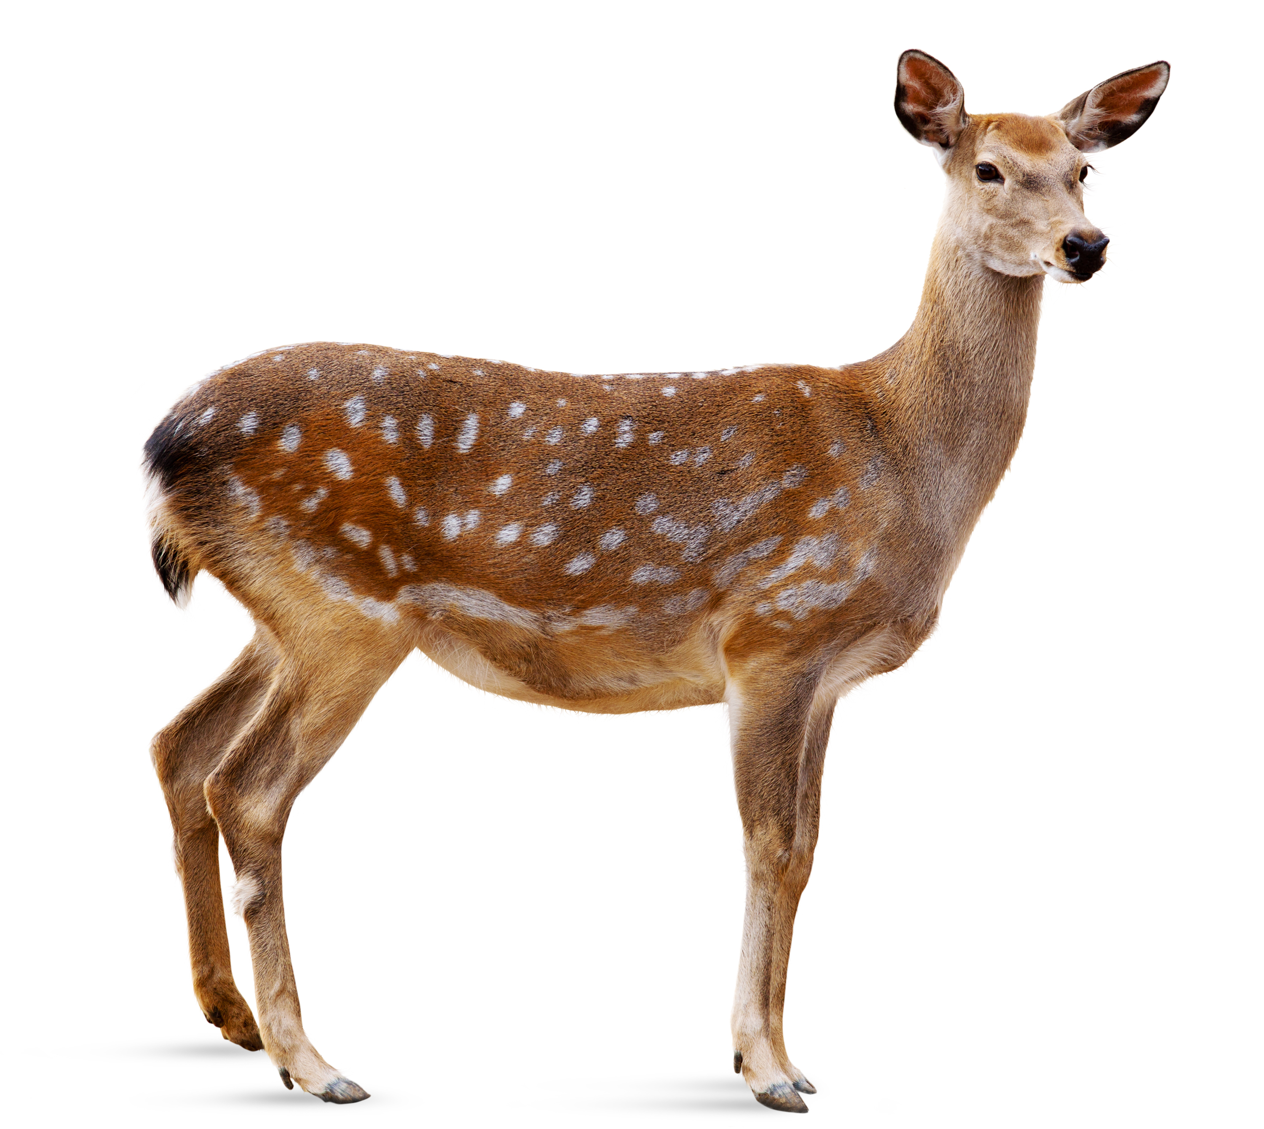
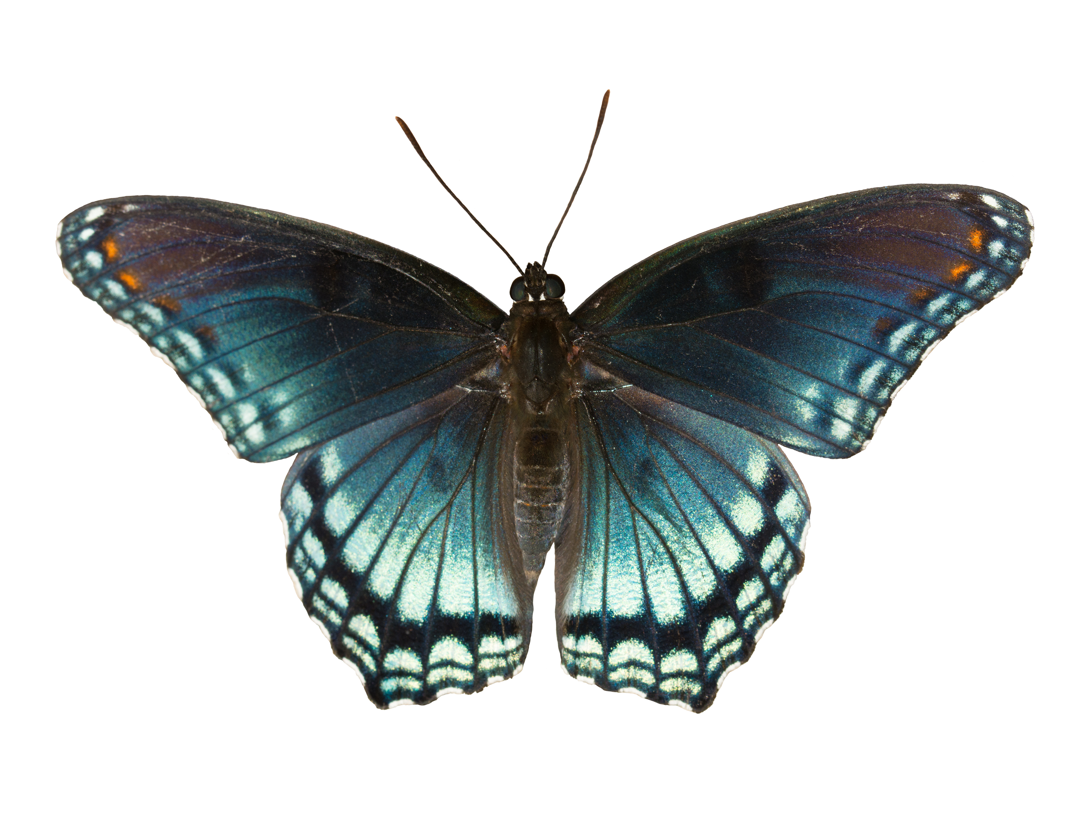
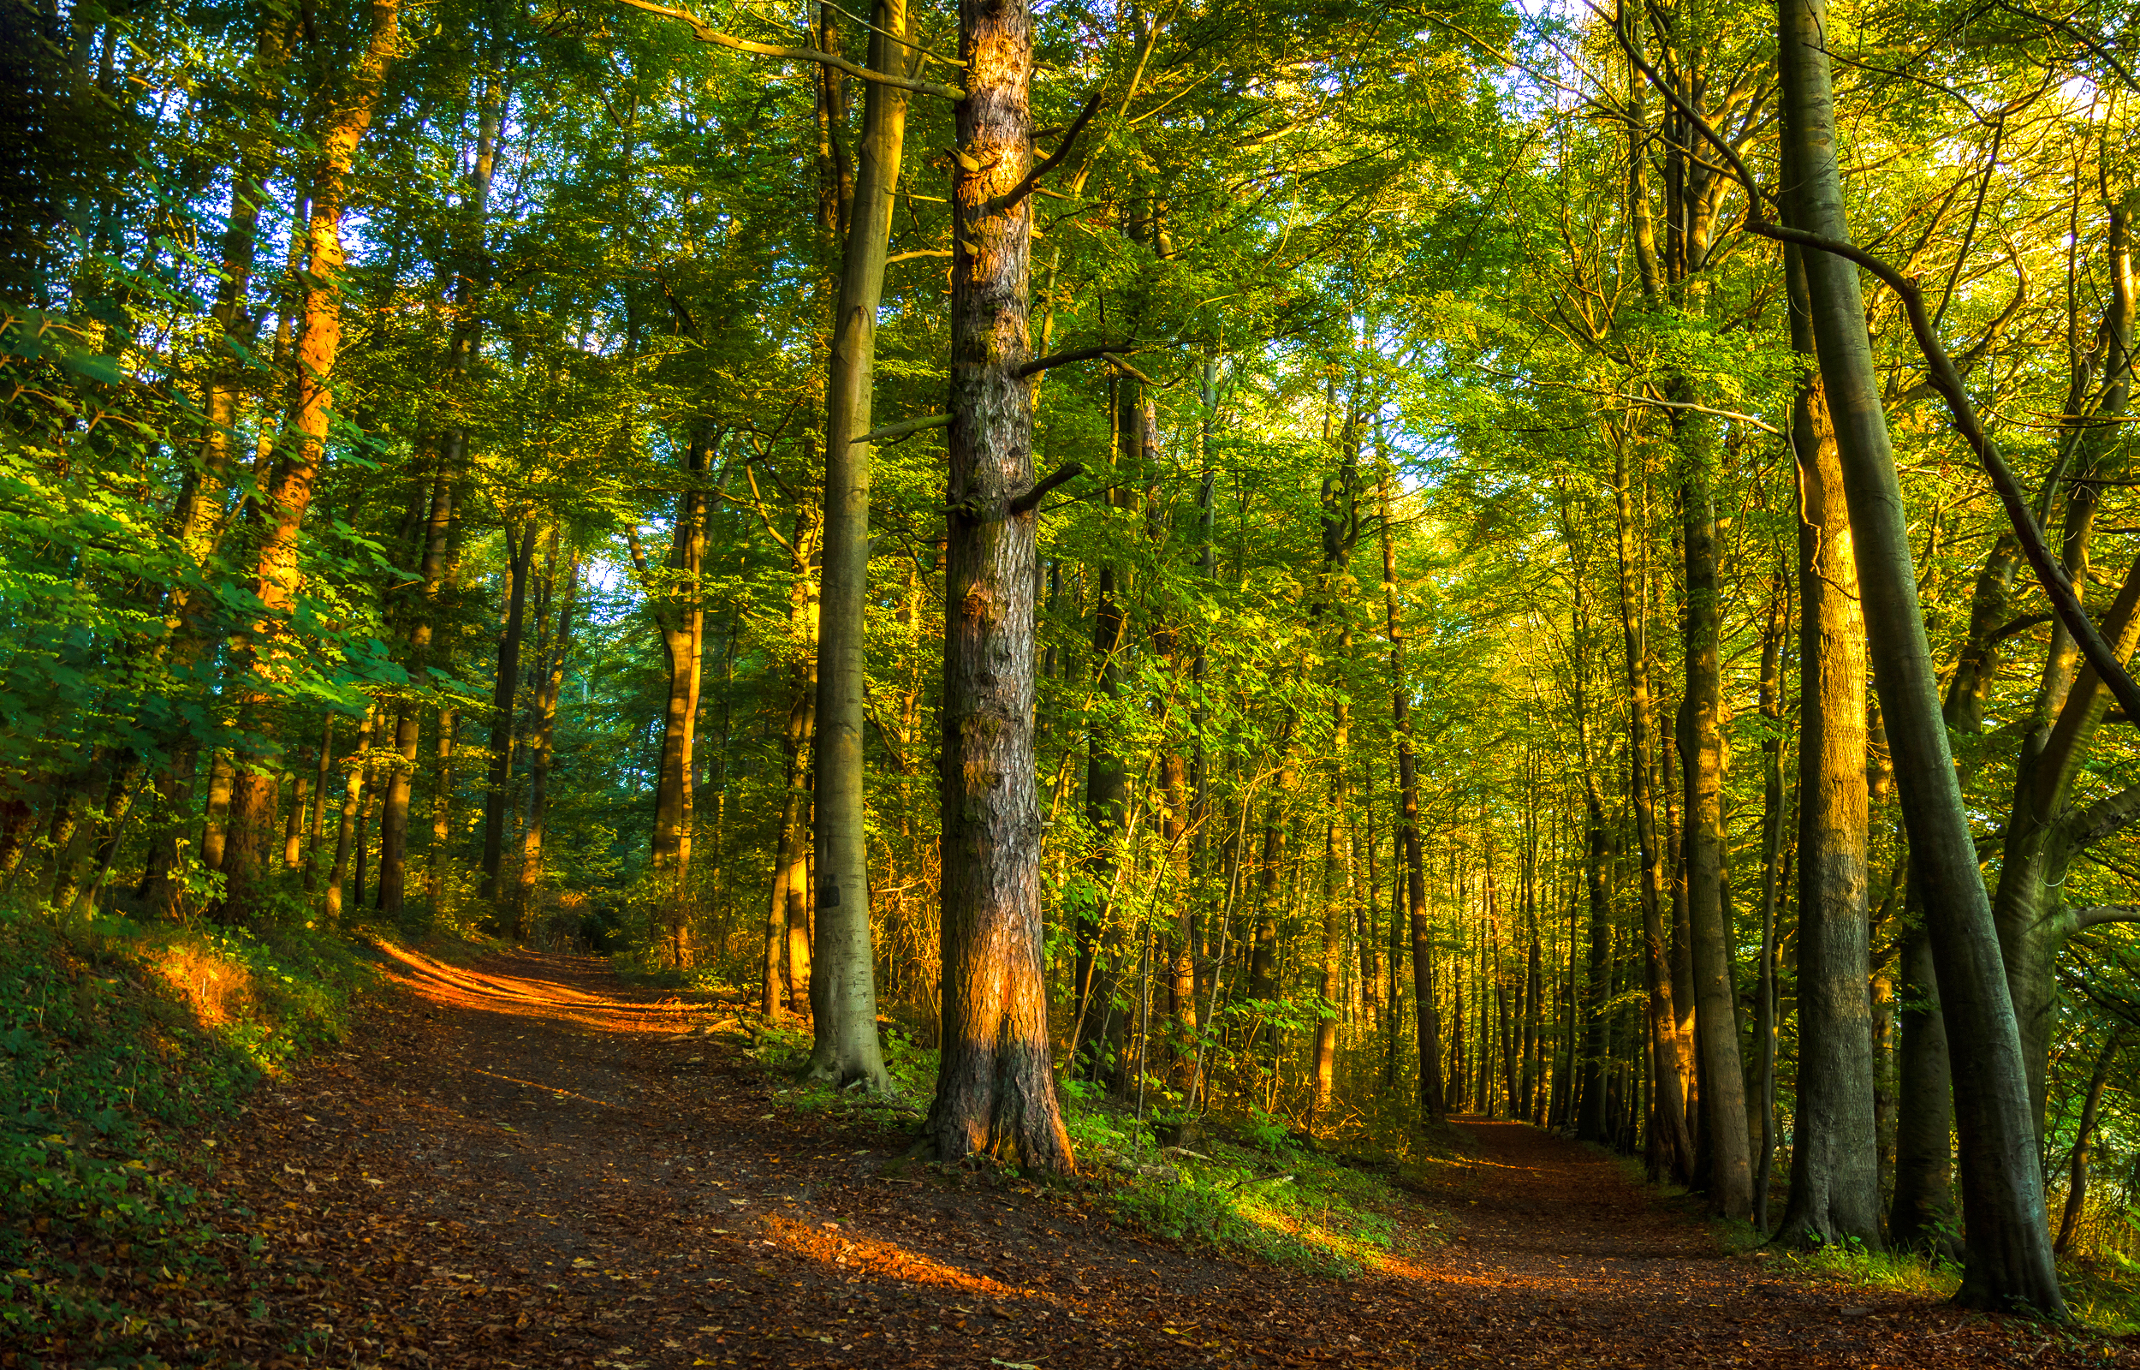
Card Sort
Notes:
Tell students they will work with their group to observe photographs to learn more about where butterflies live.
(VIRTUAL DIRECTIONS ABOUT SMALL GROUPS AND BREAKOUT ROOMS)
Distribute a set of organism cards to each group. Ask students to sort the cards into categories of their choice. Tell students that the cards in each category should be related and that they must be able to justify why they grouped the cards the way they did. After providing students a few minutes to sort the cards, ask for volunteers from each group to share the categories they came up with.
Ask students in each group to put all their cards back into one pile. Challenge students to think of a single category that includes all the cards.
What would you title this category?
VIRTUAL SESSION:
Direct participants to the Level 3 Module 2 Lesson 1 Card Sort PowerPoint file on the landing page. Instruct participants to work in groups to sort the cards into categories of their choice. Inform groups that they should be able to explain and justify their choices.
Send the landing page link through the chat: https://science.greatminds.org/pd/virtual-k-5-launch
Send directions through the chat.
Create breakout rooms of 3–5 participants.
Send participants to breakout rooms for 4 minutes.
After participants return from their breakout rooms, have each group’s reporter share the categories their group created and how they grouped the cards. Ask participants the following question: If you had to group the cards into a single category, what would it be? Why?
Tell participants that this lesson introduces students to the term organism, which describes all living things, including all plants and animals, but that students have the opportunity to engage in an investigation before the term is introduced and defined.
Remind participants of the butterfly sketch they drew. Invite participants to update their sketch to show where a butterfly lives and what it needs to survive. Remind participants that the organisms they observed in the card sort activity can all be found where butterflies live. Give participants 2 minutes to complete their sketch.

